Slide 1


Welcome
AU BoV – CCAF Subcommittee
JBSA – Lackland, TX
14 – 15 February 2023
Notes:
Good morning / afternoon and welcome to the Community College of the Air Force or CCAF.
I am (rank/name), currently serving as _______________ here at the Community College of the Air Force; I will be your briefer for today.
Before I get started (take care of any administrative business, planned breaks, introductions, and the like).

Slide 2
AU BoV Annual Cycle
Meetings to Report to SecAF*
AFIT Subcommittee Meeting (Oct)
AFIT Subcommittee Rpt. Incorporated
CCAF Subcommittee Meeting (Feb)
Parent Committee Meeting (Nov)
AU Responds to all Findings
AU BoV provides findings
Parent Committee Meeting (Apr)
CCAF Subcommittee Rpt. Incorporated
AU BoV provides findings
AU Responds to all Findings
Report “SecAF-level” items to SecAF via report, VTC, or face-to-face (May – Aug)
Implements applicable “AU-Level” findings
Implements applicable “AU-Level” findings
SecAF Follow-up items. Implemented immediately or by next AU BoV Meeting.
SecAF Report Items
Follow-up items from Prior Apr Mtg
Follow-up items from Nov Mtg
* DFO Coordinates and Plans.

Slide 3
2023 Board of Visitors
CCAF Subcommittee
Lt Col Kevin Pond, Commander and Commandant
CMSgt Alexius Reid, Senior Enlisted Leader and Vice Commandant
13 Feb 2023
Notes:
Good morning / afternoon and welcome to the Community College of the Air Force or CCAF.
I am (rank/name), currently serving as _______________ here at the Community College of the Air Force; I will be your briefer for today.
Before I get started (take care of any administrative business, planned breaks, introductions, and the like).

Slide 4

Welcome!
Dr. Ruben M. “Mike” Flores, Chair, CCAF Subcommittee
Col (Ret) Michael D. Cartney, USAF
Ms. DeeJay J. Mailer
Dr. Mary A.Y. Okada
Dr. Elane Seebo
Notes:
Good morning / afternoon and welcome to the Community College of the Air Force or CCAF.
I am (rank/name), currently serving as _______________ here at the Community College of the Air Force; I will be your briefer for today.
Before I get started (take care of any administrative business, planned breaks, introductions, and the like).

Slide 5
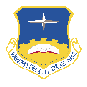
Agenda
The CCAF System
Faculty Qualification
Credit Hour Awarding Policy
Embedded Credentials
CCAF Student Engagement

Slide 6
CCAF Executive Summary
50+ years, CCAF has awarded credentials, certificates, & degrees
The CCAF degrees are:
  Reputable – Through Air University’s institutional accreditation
  Portable – Can transfer to accredited universities and colleges
CCAF’s portfolio is growing:
  Manage $10M AF Credentialing Opportunities On-Line Program
  Now authorized to provide degrees to Sister Services*
*Limited to those attending CCAF instructional site.
Notes:
CCAF has along and rich history and its inception has an interesting backstory. The U.S. in the 1960s found the civilian workforce was severely lacking people who were highly technically skilled in areas like electronics, maintenance, and medical vocations. Although there were civilian programs that offered training in these fields, many experts believed that those pipelines would be insufficient to meet growing demands.
So a group of educators in Utah approached the Air Force at Ogden Logistics Center and asked if they could look at how the Air Force taught those skills. And together, they setup and conducted a fairly expansive study that became known as “The Utah Project” This study compared the Air Force training methods with those of civilian education institutions. The study revealed that in less time, the Air Force training methods and curriculum produced markedly better outcomes.
But there was no system for translating this outstanding training into terms understood and recognized by the civilian sector.
This caused AF leadership to ask “why not capitalize on that advantage and create our own institution where we can accredit our own education and training? How powerful would that be for recruiting and retention?”
The answer to this dilemma was the establishment of the Community College of the Air Force on 1 April 1972. Initially, the college offered career education certificates. But as the prestige and enrollment of the college increased, the Air Force sought degree-granting authority for the college from Congress. On 14 July 1976, President Ford signed Public Law 94-361 authorizing the Commander of Air Training Command to confer the associate degree. We’re excited to be celebrating the 50th anniversary of CCAF on April 1st of next year.

Slide 7



The CCAF Brand
CCAF Mission & Vision
By the Numbers: (CAO Feb 23)
272k registered students
6.5k instructors
111 instructional sites
69 degrees (58 are STEM)
25 credit-awarding credentials
Gen Ed Mobile
  145 partner schools
AU-Associates to Bachelors
  100 partner schools
  375 degree programs
AFCOOL - $10M+/yr
Mission
Provide enlisted professionals pathways to degrees and credentials through military education, training, and experience.
Vision
A great place to serve while being the educational partner of choice.

Slide 8

















Complexity of CCAF
Key Stakeholder Relationships
Commands External to AETC *
Legend:
Oversight
Reporting
EPME

Slide 9





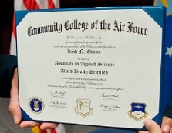










CCAF’s Associate Bachelorette Credential (ABC) Competitive Advantage
Air Force Credentialing Opportunities On-Line (AFCOOL)
Industry-based, Credit-awarding Credentials
Bachelor’s
Degree
General Education Mobile (GEM)
Air University – Associate to Baccalaureate Cooperative (AU-ABC)
BMT
Technical Training
5-lvl Upgrade
ALS
7-lvl Upgrade
NCOA
SNCOA
CLA
Accession
5 years
10 years
15 years
20 years
Retirement

Slide 10
Agenda
CCAF Executive Summary
Faculty Qualification
Credit Hour Awarding Policy
Embedded Credentials
CCAF Student Engagement
Questions to Consider:
How does CCAF compare to civilian institutions?
Opportunities for improvement?

Slide 11
Faculty Qualification Standards
SACSCOC Reference:
6.1 The institution employs an adequate number of full-time faculty members to support the mission and goals of the institution.
6.2 For each ... program, the institution justifies and documents the qualifications of its faculty ...
6.5 The institution provides ongoing professional development opportunities for faculty members.
Notes:
The emphasis is on overall qualifications of a faculty member, rather than simply academic credentials. While academic credentials in most cases is the standard qualification for faculty members, other types of qualifications may prove to be appropriate (Ex: work experiences in the field, professional licensure and certifications). These types of qualifications are especially important in professional, technical, and technology-dependent fields.
Faculty Credentials Guidelines
E. Faculty teaching associate degree courses not designed for transfer to the baccalaureate degree: bachelor’s degree in the teaching discipline, or associate’s degree and demonstrated competencies in the teaching discipline.

Slide 12
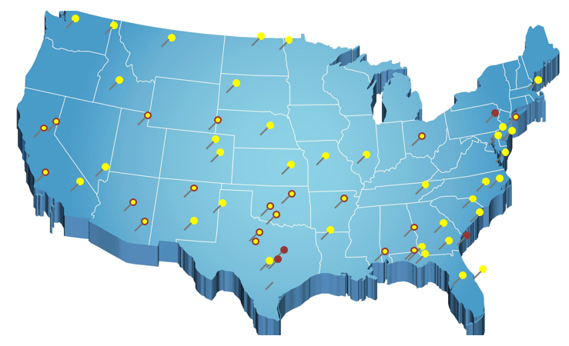

Faculty & Campus Relations
Goal: Ensure all CCAF off-campus instructional sites remain in good standing, enabling AU to award credit towards AAS degrees.
111 sites
6.5k faculty
2.3k+ courses

Slide 13
Building CCAF’s Faculty
Faculty Selection:
Each school determines policy/procedure
Candidates: Active Duty AF, Guard, Reserve, Sister Services, International Services, & Civilians
Requirements:
  AAS* in Air Force Specialty;
  At least Journeyman skill level (5 level)
  3-4 years of work experience in specialty
  *Candidates allowed one year to complete, if not already holding AAS upon selection.
Notes:
Faculty Selection
Each institution determines policy/procedure
Candidates from active-duty Air Force; Guard/Reserve components; sister services; international services; civilians
Requirements: 1) AAS in Air Force Specialty Code; 2) 5 level “Journeyman” status; 3) 3-4 years of work experience
Degree may be excepted at time of assignment; candidates allowed one year to complete
Policies, Procedures and Guidelines (PPG): Instructor Onboarding
Instructor Methodology (3 SH)
Instructor Internship (180 hours)
120 hours podium instruction
30 hours curriculum development
30 hours teaching qualification (administer tests, counsel students, evaluations, subject matter testing)
3 evaluations performed by qualified faculty
Subject Matter Testing on every course.
Annual requirements: evaluations, professional development, subject matter testing

Slide 14
Building CCAF’s Faculty
Instructor Onboarding Process:
Instructional Methodology (3 SH)
CCAF Teaching Internship (180 hours)
  120 hours podium instruction
  30 hours curriculum development
  30 hours teaching qualification (administer tests, counsel students, etc.)
  3 evaluations performed by qualified faculty
  Subject Matter Testing on every course taught
Annual Requirements:
Evaluations, professional development, & subject-matter testing
Notes:
Faculty Selection
Each institution determines policy/procedure
Candidates from active-duty Air Force; Guard/Reserve components; sister services; international services; civilians
Requirements: 1) AAS in Air Force Specialty Code; 2) 5 level “Journeyman” status; 3) 3-4 years of work experience
Degree may be excepted at time of assignment; candidates allowed one year to complete
Policies, Procedures and Guidelines (PPG): Instructor Onboarding
Instructor Methodology (3 SH)
Instructor Internship (180 hours)
120 hours podium instruction
30 hours curriculum development
30 hours teaching qualification (administer tests, counsel students, evaluations, subject matter testing)
3 evaluations performed by qualified faculty
Subject Matter Testing on every course.
Annual requirements: evaluations, professional development, subject matter testing

Slide 15
Current CCAF Faculty
Total Faculty: 6488
Total Pursuing Degree: 693
Total Faculty: 6488

Slide 16
Agenda
CCAF Executive Summary
Faculty Qualification
Credit Hour Awarding Policy
Embedded Credentials
CCAF Student Engagement
Questions to Consider:
How does the AU method of calculating credits compare with your institution?
What other calculation practices are available?
Is it a viable practice to use multiple calculation ratios in one institution?
Notes:
Understanding how CCAF and AU calculates credit hours from contact hours, how does your institutions calculate credits?
How does this intersect or diverge from the CCAF and AU methods?
Please provide your insight from your experience how a university (graduate) differs from a Community College (undergraduate) regarding program development, credit awarding, and overall governance.
What contact hour to credit ratio does your institution use to determine credits or do you use various formulas to calculate the different modalities such as independent study, lecture, lab, practicum, clinical, etc.?
Do you feel it is a viable practice to use a singular ratio or formula to calculate credit hours across the various types of teaching methods?

Slide 17
Relevant Credit Hour Policy
Air University Instruction 36-2602:
6.8.1. Contact Hours and Credit Hours.
  Definition of contact and credit hour comes from 34 CFR § 600.2
6.9.1.1.1. A credit hour consists of 45 instructional contact hours.
  Contact hours may consist of classroom, direct faculty, or self-paced instruction and out of class student work.
Notes:
6.8.1. Contact Hours and Credit Hours. AU employs the definition of contact and credit hour from 34 CFR § 600.2 for credit-bearing and non-credit-bearing programs. Courses that are part of an approved degree-granting program result in academic credit hours. Courses that are not part of an approved degree-granting program result in contact hours
6.8.2. Academic program coordinators, or appropriate designee, will validate the numbers of contact (Clock) hours or credit hours for their respective programs with AU/OAA and AU/UR offices each year through their AU Catalog submission describing their program offerings. If contact or credit hours change, notify AU/OAA immediately
6.9.1.1.1. A credit hour consists of 45 instructional contact hours . Contact hours may consist of classroom, direct faculty, or self-paced instruction and out of class student work. An equivalent amount of work for other academic activities including laboratory work, wargames, field studies, practicum, independent research and writing, and other academic work will lead to the award of credit hours
Why 45? Carnegie units were designed for payroll of faculty, not to assess credit hours. Most Community Colleges use 37.5 hours. Neither the DoE nor SACSCOC mandate 45.

Slide 18
Previous and Current Calculations
Previous Calculations Examples
  15:1 for direct faculty lecture
  30:1 for lab, performance, demonstration, etc.
  45:1 for medical clinicals
  Factored 2 hrs of out-of-class student work per 1 contact hr
Current Calculations Example
  45:1 for all student learning activities

Slide 19
Course Credit Comparison
AFSC | Specialty | Current Credits Awarded | Credits Awarded under 45:1 Policy | Hours Short 45 credit hour requirement
1N | Intel | 56 | 33 | 12
1W | Meteorology | 99 | 32.5 | 12.5
3E | EOD | 83 | 27.5 | 17.5
3P | Security Forces | 45 | 14.5 | 30.5
5J | Paralegal | 63 | 22.5 | 22.5

Slide 20
Tuition Assistance Impact
AFSC | Specialty | Number of Students* | Additional Credits Required per Student | Total TA Cost Increase**
1N | Intel | 16,017 | 12 | $ 48,051,000
1W | Meteorology | 2,024 | 12.5 | $ 6,325,000
3E | EOD | 1,417 | 17.5 | $ 6,199,375
3P | Security Forces | 29,359 | 30.5 | $ 223,862,375
5J | Paralegal | 590 | 22.5 | $ 3,318,750
*Students Enrolled in 2017 – 2022 Catalogs
**Tuition Assistance (TA) Cost per Credit hr = $250
Total = $287,756,500

Slide 21
Agenda
CCAF Executive Summary
Faculty Qualification
Credit Hour Awarding Policy
Embedded Credentials
CCAF Student Engagement
Questions to Consider:
How does your institution, determine what certifications to embed your degree programs?
How do you go about creating credentials that are recognized by industry?

Slide 22
Current Programs
Certificate programs
    CCAF Qualified Faculty
  CCAF Instructor Certificate (CIC)
  Instructional Systems Development (ISD) Certificate
    Aircraft Maintenance
  JSAMTCC* FAA** Airframe and Powerplant Certificate of Eligibility
Air Force Credentialing Opportunities On-Line (AFCOOL)
1,500+ credentials - From Aircraft Maintenance to Project Management
Credentials can be evaluated for college credit
No or limited out-of-pocket cost to the member
*JSAMTCC – Joint Service Aviation Maintenance Technician Certification Council
**FAA – Federal Aviation Administration
Notes:
Embedding professional certifications and licenses into CCAF degree pathways
Many community colleges integrate professional certifications and licenses
Member must have a certification as part of their degree pathway
AFCOOL offers certifications and licenses for all AFSCs
Certifications mapped to match 80% of training received up to 5-level
AFCOOL Funded – up to $4,500 lifetime cap
Minimal to no out-of-pocket expenses to the member
CCAF awards academic credit for certifications and licenses
CCAF Workforce Development evaluates certifications for credit
Effective IE/IR tool to measure degree program outcomes
Validates education, training, and job experience
Creates a better trained, multi-capable Airman

Slide 23
CCAF Certificate Programs
CCAF Qualified Faculty
CCAF Instructor Certificate (CIC) (Level I, II, and III)
  Three levels based on the instructor’s teaching experience and education
  Used as an entry point for K-12 educator licensure in Florida and Alabama
    Legislation is pending in Texas (SB544) to mirror Florida legislation
Instructional Systems Development (ISD) Certificate
  Awarded to CCAF course curriculum developers
  Recognizes practical experience and education of curriculum writers
  Used as an entry to civil service (GS-1750), Fortune 500 companies (training development), colleges/university/K-12 curriculum writers

Slide 24
CCAF Certificate Programs
Aircraft Maintenance
JSAMTCC* FAA** Airframe and Powerplant Certificate of Eligibility
  Requirements for Certificate of Eligibility
    Qualification Training Package
    3 Specialized Courses: General, Airframe, and Powerplant
    30 months of experience in Airframe and Powerplant Systems
  Benefits:
    Technician can bypass FAA interviews and proceed to written, oral, and practical exams
    CCAF awards 30 semester hours collegiate credit for awarded FAA A&P certification
    Aviation industry opportunities after transition from Air Force
    Develops a more well-rounded and diverse aircraft maintenance technician
*JSAMTCC – Joint Service Aviation Maintenance Technician Certification Council
**FAA – Federal Aviation Administration
Notes:
* JSAMTCC – Joint Service Aviation Maintenance Technician Certification Council
* FAA – Federal Aviation Administration

Slide 25
Top 10 AFCOOL Credentials
Credential | Total Enrolled
General Radiotelephone Operator License (PG) | 6306
Project Management Professional (PMP) | 3451
Mechanic (Airframe & Powerplant) | 3174
Certified Associate in Project Management (CAPM) | 1330
ASTM NCATT Aircraft Electronics Technician (AET) | 914
CompTIA Security+ | 807
Certified Information Systems Security Professional (CISSP) | 696
Certified Personal Trainer (NASM-CPT) | 647
Certified Manager (CM) | 398
National Council Licensure Examination for Practical/Vocational Nurses (NCLEX-PN) | 270
  Source: AFCOOL data from AFAEMS since 2015 program inception as of 31 Jan 2023

Slide 26

Multicapable Enlisted Leader/Technical Expert
17-3023 - Electronic Engineering Technologists
15-1299.06 - Digital Forensics Analysts
15-1242 - Database Administrators
13-1111 - Management Analysts
11-1011 - Chief Executives
$64k
$95k
$97k
$93k
$180k
SEL/Manager
NCO/Technician
Professional in HR
27-4012 - Broadcast Technicians
33-3021.06 –
Intelligence Analysts
11-3021 - Computer & Info Systems Managers
Six Sigma
$52k
$84k
$159k
Society of Broadcast Engineers
PMP
Intel Certs
IT Certs
15-2031 - Operations Research Analysts
19-2099.01 - Remote Sensing Technologists
$104k
$82k
49-2094 - Electrical and Electronics Repairers
Industry Certs
$62k
TA
Masters Degree
Industrial Maintenance
$82k
AU ABC
Bachelors Degree
$69k
Associates Degree
Degree
Certifications
Jobs
Military Position/Civilian Equivalent
$50k
Airmen/Apprentice
CCAF
*Annual rounded earnings by education averages retrieved from, Bureau of Labor Statistics.
Education pays, 2021, (May 2022)
**Annual rounded earnings averages retrieved from O*Net OnLine (July 2022)
1N2X1C
$42k

Slide 27
Agenda
CCAF Executive Summary
Faculty Qualification
Credit Hour Awarding Policy
Embedded Credentials
CCAF Student Engagement
Questions to Consider:
How does CCAF’s proposal compare to your institution?
Opportunities for improvement?

Slide 28
Student Advisory Panel
Membership
6 students/representatives from each enlisted tier (Amn/NCO/SNCO)
  1 ANG rep (Amn or NCO)
  1 AFRES rep (Amn or NCO)
  1 Air University rep (SNCO or civilian)
  1 OCONUS rep (SNCO from either Pacific or Europe)
  2 Reg AF AD reps outside of the above organizations (SrA-SSgt)
Student Advisory Panel Focus Areas and Functionality
Initially focus on:
  Goals, expectations, mission/vision, & Policy Council proposals
Members meet virtually periodically (quarterly); in person annually
Inputs from Panel will flow into the CCAF Policy Council then to BoV

Slide 29
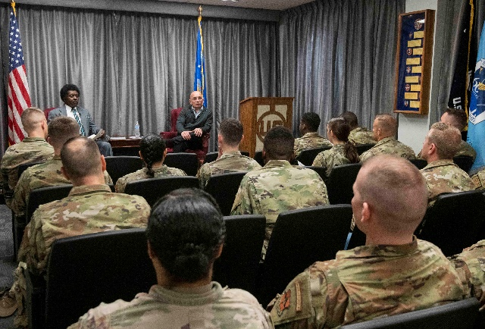
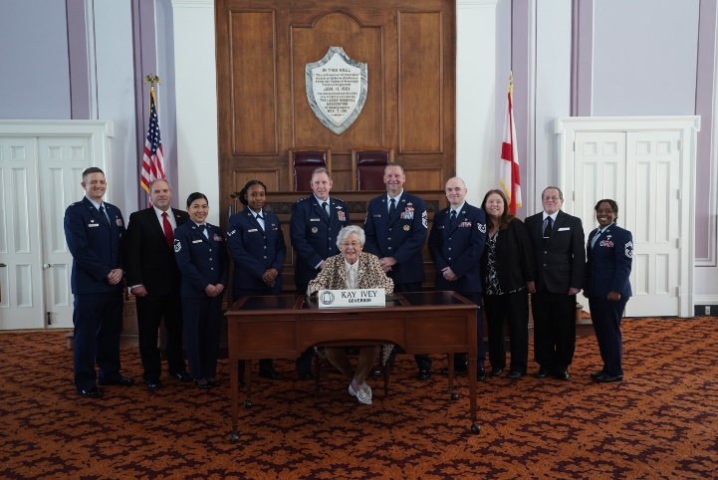
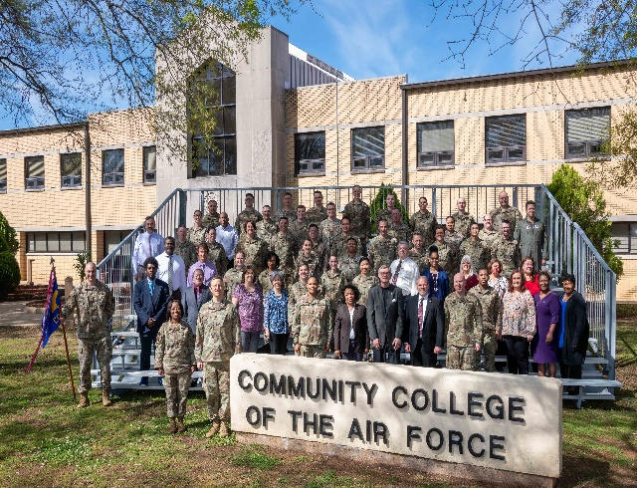
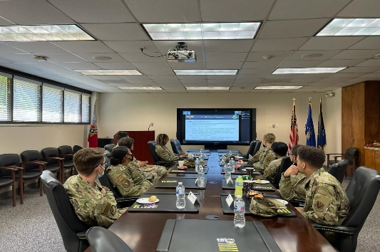
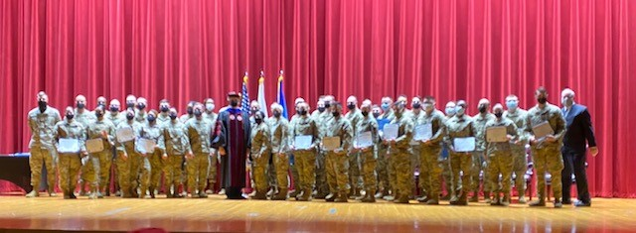
Questions?
Notes:
Even as CCAF is poised for the future, our original purposes as establish in public law remain:
To serve as a recruitment incentive
Enable mission readiness
Support retention of our outstanding personnel, and
Facilitate the career transition of our enlisted personnel towards success as contributors to society, now as civilian members of society.
Thank you for your attention, are there any questions?

Slide 30



Backup Slides

Slide 31









Institutional Accreditation
Air University is accredited by the Southern Association of Colleges and Schools Commission on Colleges (SACSCOC) to award associate, masters, and doctoral degrees.
Benefits
Credits and degrees widely accepted
Credits transferrable; degree exportable…stepping stone
Constraints
High standard: faculty qualifications, program rigor
Documentation, reporting requirements
Notes:
Regionally accredited schools are mostly academically oriented, non-profit or state-owned
Reluctant to accept transfer credits from nationally accredited institutions, mainly because the latter hasn’t met the stringent standards of faculty qualifications and library resources.
Serve a certain geographic region of the United States; some serve international regions. They accredit post-secondary institutions and primary and secondary schools.
Primarily concerned with accreditation of academically oriented, non-profit schools, rather than technical or career-based schools.
Known as institutional accreditation. It acknowledges that all components of an institution are functioning and working towards specific goals.
Nationally accredited schools are generally for-profit and offer vocational, career, or technical programs.
Generally offer accreditation to schools that focus on career or religious education.
Will generally accept credits from schools that are nationally accredited and regionally accredited.
Regional – Nat’l Diffs. Key difference: many regionally accredited institutes will not accept credits from nationally accredited institutes and vice versa. Similarly-accredited schools will generally accept transfer credits from one another as they have comparable curriculums and standards.
Programmatic, or specialized, accrediting agencies accredit programs, departments, and schools within larger universities.
Institutions with spcl’zd/programmatic accreditation generally also have institutional accreditation.
Example is ABA
General.
Agencies serving as accrediting entities must apply to the U.S. Dept of Ed for federal recognition.
The DoE establishes standards that agencies must meet, and evaluate agencies for compliance
An agency recognized by the DoE can be trusted as a valid, reputable source for accreditation.
When browsing colleges, check for accreditation AND ensure the accrediting agency is recognized by the DoE. If it is not, the school should be avoided, just as if it had no accreditation at all. The DoE maintains a list of recognized accrediting agencies at its website.

Slide 32
Air Force Credentialing Opportunities On-Line (AFCOOL)/Credentialing
AFCOOL FY22
Credentialing
Rank | Students | Enrollments | Completions (cao 26 Jan 23)
E-2 | 8 | 11 | 4
E-3 | 378 | 633 | 363
E-4 | 1012 | 1910 | 1118
E-5 | 1170 | 2298 | 1351
E-6 | 855 | 1550 | 921
E-7 | 929 | 1677 | 1014
E-8 | 290 | 510 | 330
E-9 | 135 | 236 | 182
SGT | 10 | 13 | 9
SP3 | 3 | 3 | 2
SP4 | 9 | 14 | 6
Total Graduates
CCAF Certificate Program | Graduates
FAA Airframe & Powerplant* | 2,387
CCAF Instructor Certification-I | 16,941
CCAF Instructor Certification-II | 11,317
CCAF Instructor Certification-III | 2,175
Instructional System Design | 1,060
Annual Graduates
CCAF Certificate Program | 2019 Annual Graduates | 2020 Annual Graduates | 2021 Annual Graduates | 2022 Annual Graduates
FAA Airframe & Powerplant* | 395 | 466 | 391 | 294
CCAF Instructor Certification-I | 1,008 | 1411 | 1,280 | 1,222
CCAF Instructor Certification-II | 656 | 819 | 861 | 888
CCAF Instructor Certification-III | 187 | 216 | 176 | 189
Instructional System Design | 33 | 100 | 96 | 97
Monthly Graduates
CCAF Certificate Program | July Monthly Graduates | August Monthly Graduates | September Monthly Graduates
FAA Airframe & Powerplant* | 18 | 45 | 22
CCAF Instructor Certification-I | 75 | 119 | 147
CCAF Instructor Certification-II | 92 | 72 | 73
CCAF Instructor Certification-III | 20 | 16 | 16
Instructional System Design | 1 | 7 | 9
*Combined Airframe, Powerplant, and Airframe & Powerplant numbers
Notes:
Enrollments includes the credential exams or preparatory courses
Completions are enrollments with grades reported

Slide 33
AU-ABC/General Education Partners
Air University- Associates to Bachelors (AU-ABC) Program
AU-ABC | January 2023 Data | Since Program Inception (2007) Data
Partner Schools | +0 | 100
Degree Programs | +0 | 375
Enrolled Students | 2,490 | 240,117
Course Enrollments | 3,292 | 371,396
Graduates | 189 | 13,935
Commissioned Graduates | 13 | 582
General Education Mobile (GEM) – CCAF General Education Partners
GEM | January 2023 Data | Since Program Inception (2009) Data
Partner Schools | +1 | 145
Approved Courses | +20 | 2,703
Enrolled Students | 1,864 | 170,689
Course Enrollments | 2,149 | 198,941

Slide 34
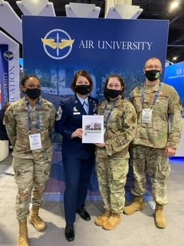
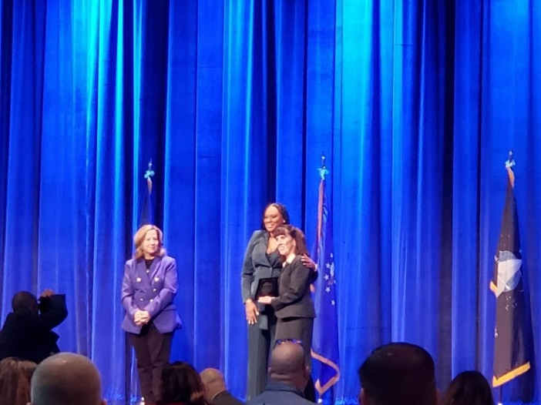
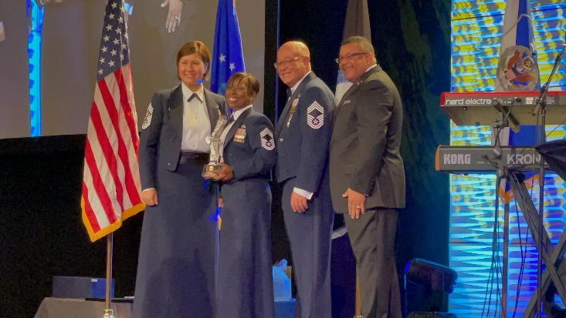
CCAF Achievements

Slide 35


37th Training Wing
CFETP to Curriculum Process
Mr Timothy Ori
37 TRG/TA
14 Feb 23
This Briefing is: Unclassified

Slide 36
CFETP PURPOSE
Career Field Enlisted Training Plan
Lists Career Field Progression Requirements:
  3-9 Level
    3 Level Technical Training awards Air Force Specialty Code (AFSC) upon graduation from training
    5 Level training normally upgrade or career development courses
    7 Level training advanced/supplemental training commensurate with grade/rank
    9 Level training SNCO training focused on leadership and management within AFSC

Slide 37
CFETP PROCESS
Career Field Managers (CFMs) determine what needs to be taught/trained at each level within their career field
Specialty Training Requirements Team:
  CFM
  MAJCOM CMSgts
  2AF Training Pipeline Manager PM,
  Schoolhouse Training Manager (TM) and Training Development Chief (TDE)
Determine training line items and proficiency levels for each level
Training Managers work with TDE Chief and Course Managers to develop training that meets the CFMs vision

Slide 38
CFETP EXAMPLE
Security Forces CFETP

Slide 39
CFETP PROFICIENCY CODE KEY
  Subject Knowledge:
    A: Can identify basic facts and terms about the subject. (Facts) Facts think nomenclature
    B: Can identify relationship of basic facts and state general principles about the subject. (Principles)
    C: Can analyze facts and principles and draw conclusions about the subject. (Analysis)
    D: Can evaluate conditions and make proper decisions about the subject. (Evaluation)
  Task Knowledge:
    a: Can name parts, tools, and simple facts about the task. (Nomenclature)
    b: Can determine step by step procedures for doing the task. (Procedures)
    c: Can identify why and when the task must be done and why each step is needed. (Operating Principles)
    d: Can predict, isolate, and resolve problems about the task. (Advanced Theory)
  Performance Level:
    1: Can do simple parts of the task. Needs to be told or shown how to do most of the task. (Extremely Limited)
    2 Can do most parts of the task. Needs only help on hardest parts. (Partially Proficient)
    3 Can do all parts of the task. Needs only a spot check of completed work. (Competent)
    4: Can do the complete task quickly and accurately. Can tell or show others how to do the task. (Highly Proficient)

Slide 40
COURSE DEVELOPMENT
ADDIE Instructional System Development Methodology
  Analysis: Done by CFM at STRT and CFETP creation
  Design: Accomplished by TDE personnel
  Develop: Accomplished by TDE personnel
  Implement: Accomplished by Instructor Cadre
  Evaluate: Accomplished thru internal and external feedback processes
    Most important piece of the ADDIE mode
    Provides feedback from students to instructors and TDE while students are in the course
    External feedback provides feedback from students/supervisors at 6 months on the job

Slide 41
COURSE ENTERS CCAF PROCESS
When the course is completed the course is sent to CCAF to determine the amount of credits a student will earn upon successful completion
After students graduate from the class the schoolhouse notifies CCAF
the student graduated; CCAF updates transcript entry for that student
and awards credit
As student progresses thru their career CCAF captures students information and tracks it to completion of their AAS degree
RELATIONSHIP BETWEEN SCHOOLHOUSE AND CCAF CRITICAL FOR STUDENT DEGREE COMPLETION

Slide 42

Commander’s
Comments

